Slide 1
AI Software
Testing Tools
22125020 - Nguyen Bach Truong Giang
22125071 - Dang Minh Nhut
22125008 - Luu Quoc Bao
22125035 - Nguyen Vinh Khang

Slide 2
Table of Contents
AI for Test Case Design
Experiment: AI for Test Case Design
AI for Unit Testing
Experiment: AI for Unit Testing

Slide 3
2025

Slide 4
How testers do their job
1
2
3
Requirements analysis
Test planning
Test design
6
5
4
Test closure
Test execution
Environment setup

Slide 5
How testers do their job
1
2
3
Requirements analysis
Test planning
Test design
6
5
4
Test closure
Test execution
Environment setup

Slide 6
How testers do their job
3
Test case
Test design
Test data
Time consuming
Human error

Slide 7
1 - AI For Test Case Design

Slide 8
What can AI help?
Test data generation
Test case generation

Slide 9
INPUT
User stories,
requirements specification
Source code/GUI

Slide 10


User stories and requirements specification
User stories
Test case design
Test case/data generation
Review
Requirements specification
ChatGPT
Browserstack
AI Test Case Generator
GEMINI
…

Slide 11
No specification at all
Source
Scenarios
Test case
Later steps
Exploratory Testing
Ad-hoc Testing

Slide 12
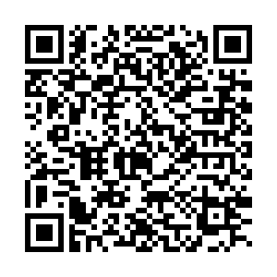

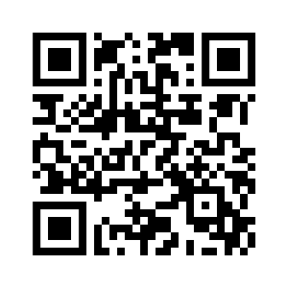
No specification at all
Paper
YouTube

Slide 13
up to 80%
test case creation time
(artificial intelligence (AI)–powered extension of VEW built on AWS for automotive testing)[1]

Slide 14
2 - Experiment
AI For Test Case Design

Slide 15
Set up
LLM: Gemini 3 Pro, GPT-5.1
Turn on “Thinking” Mode
Turn off “Learn from Past Chat” for Gemini
3 Levels of Prompt
User Story + AC
User Story + AC + Testing Technique
User Story + AC + Testing Technique + High level TC

Slide 16
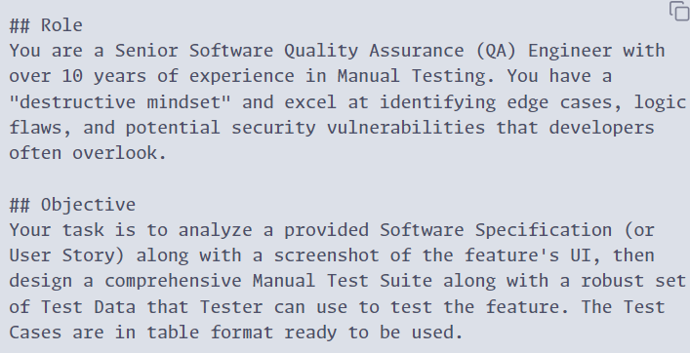
Prompts - Context (All)

Slide 17
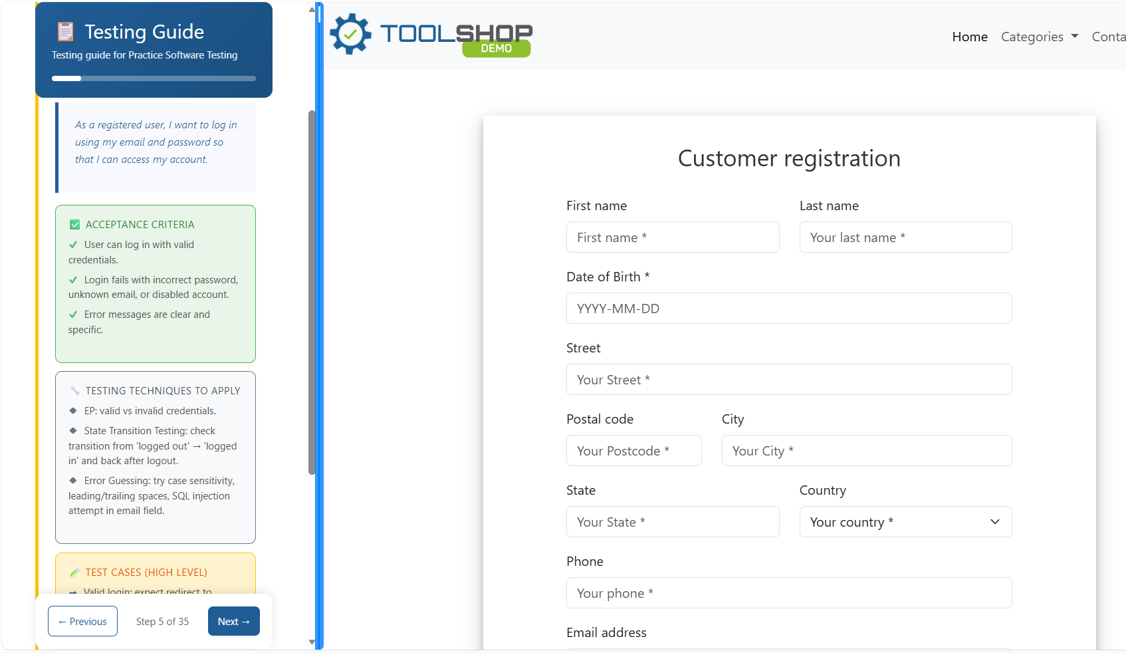
Prompt - Specification Source

Slide 18
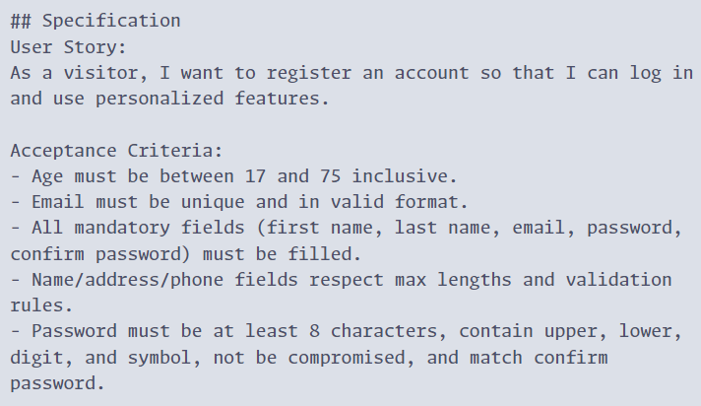
Prompts - User Story + Accept Crit (All)

Slide 19
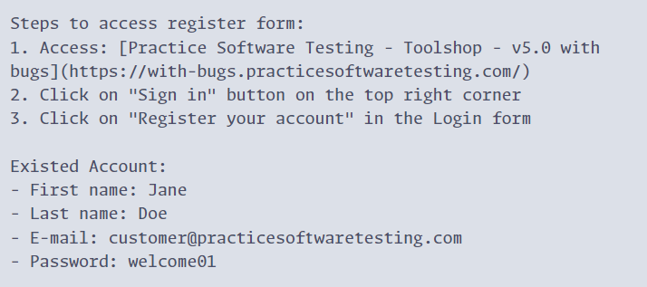
Prompt - Additional Instructions (All)

Slide 20
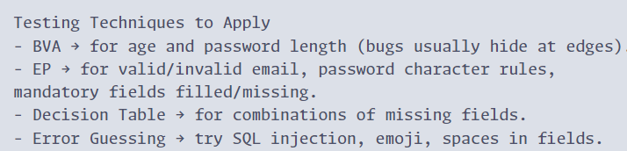
Prompt - Testing Technique (P2, P3)

Slide 21
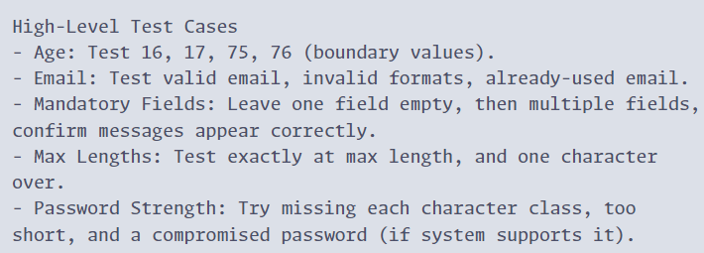
Prompt - High Level TC (P3 only)

Slide 22
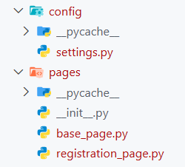
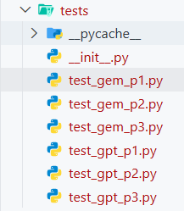
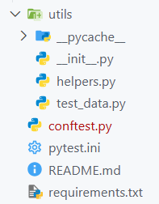
Test scripts

Slide 23
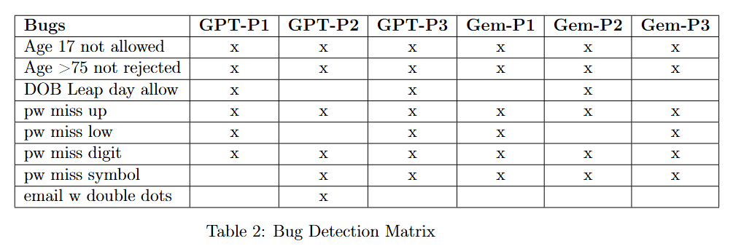
Results - Bugs
Only GPT with Prompt 2 detected “Email with double dots allowed” bug.
Only 3/6 suites check for DoB leap day handling.

Slide 24
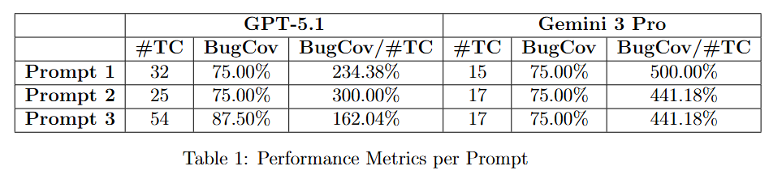
Results - Bugs Coverage
Gemini gives less test cases than GPT while maintain similar bugs coverage.

Slide 25
3 - AI For Unit Testing

Slide 26
What is Unit Testing?
Developer-focused practice of testing individual code components in isolation to verify their correctness

Slide 27
When to do Unit Testing?
During development
Before factoring
Part of Continuous Integration (CI)
When fixing a bug

Slide 28
How a developer writes unit tests
1
2
Analyze code requirements
Design tests
4
3
Run test (CI/CD)
Implement

Slide 29
The unit testing paradox
Why Developers "Hate" Testing
Repetitive “busywork”
The "Coverage Illusion"
100% Coverage ≠ 100% Bug-free.

Slide 30
What can AI really do for Unit testing?
1
2
Generate test scaffolding
Coverage-Driven Generation
4
3
Test repair & Enhancement
Autonomous test suite creation

Slide 31

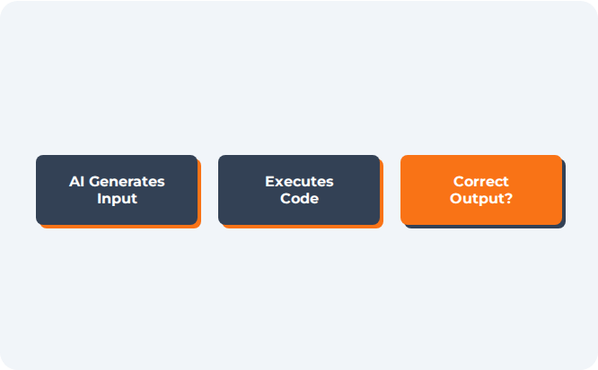

The fundamental limitation
The Test Oracle Problem
It can run
BUT it can't judge
MISSING CONTEXT
•
Risk: If your code has a bug, the AI might write a test that passes the bug, treating the error as "correct behavior".

Slide 32
The fundamental limitation
The Test Oracle Problem
You are the ORACLE
MISSING CONTEXT
•
Risk: If your code has a bug, the AI might write a test that passes the bug, treating the error as "correct behavior".

Slide 33
4 - Experiment
AI For Unit Testing

Slide 34


UnitTestAI
Qodo
Generate test cases by observing function signature, code in function and natural-language comment

Slide 35
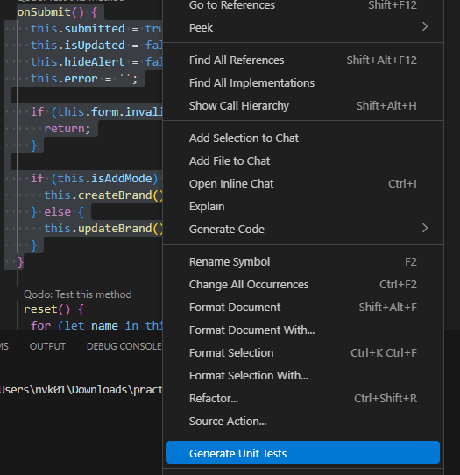
UnitTestAI
Automatic language detection based on the selected code block.
Framework suggestions: Provides a list of relevant test frameworks for the detected language.
Highly versatile and user-friendly, allowing developers to keep using their preferred tools and testing practices.

Slide 36
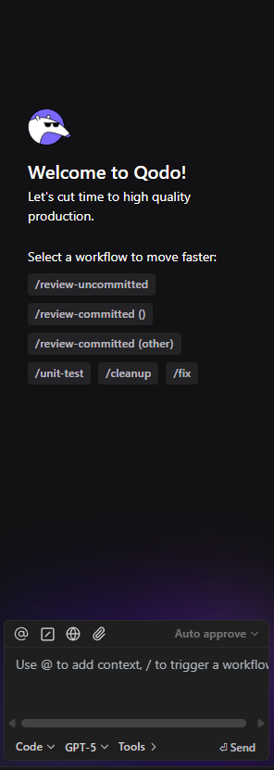
Qodo
Automatic test generation for new or changed code, improving test coverage.
Customizable rules that enforce organizational testing, quality, and security standards consistently.
High-precision automated code reviews
1-click issue resolution to quickly fix detected problems.

Slide 37


Experiment Design
Code Coverage
Test Suite Efficiency
Readability & Documentation
Tools
Dataset
Criteria

Slide 38
Experiment Result - Code Coverage
Qodo | UnitTestAI
Qodo effectively achieved full logical coverage by explicitly creating tests for all possible outcomes and failure modes defined by the problem's constraints. | UnitTest AI provided good baseline coverage, ensuring the function works for sample cases, basic inputs, and standard boundary conditions.

Slide 39
Experiment Result - Test Suite Efficiency
Qodo | UnitTestAI
Sacrifices Speed for Strength. Introduced heavy-duty helper functions, such as the brute-force optimizer in Problem 2. This approach guarantees the optimal solution is checked, but it can lead to significantly longer execution times as the constraints increase. | Prioritizes Speed. All tests run quickly as they rely purely on the tested algorithm without computationally expensive verification (like brute force). This makes for faster developer feedback cycles.

Slide 40
Experiment Result - Readability and Documentation
Qodo | UnitTestAI
Superior Clarity. Each test function is often accompanied by detailed comments explaining the logical purpose, expected path, and reasoning for the case, significantly aiding human understanding and debugging. | Functional Clarity. Uses clear, descriptive function names, but generally lacks the rich, problem-specific commentary provided by Qodo, relying on the test's input/output to convey its purpose.

Slide 41

Demo - UnitTestAI

Slide 42
BUT
Privacy
HUMANS
Generative AI is probabilistic.

Slide 43
QnA

Slide 44
References
[1] Tobias Drees, Daniel Krumpholz, and Stanislav Kruglov. Using generative ai to create test cases for software requirements | aws for industries, Jan 2025. https://aws.amazon.com/blogs/industries/using-generative-ai-to-create-test-cases-for-software-requirements/.
[2] Tariq M. King, Jason Arbon, Dionny Santiago, David Adamo, Wendy Chin, and Ram Shanmugam. Ai for testing today and tomorrow: Industry perspectives. In 2019 IEEE International Conference On Artificial Intelligence Testing (AITest), pages 81–88, 2019. doi: 10.1109/AITest.2019.000-3.
‌

Slide 45
Acknowledgements
User icons created by Ch.designer - Flaticon
Artificial intelligence icons created by FACH - Flaticon

